Slide 1

Year 5
HASS: civics and citizenship
Lesson 1 – what is civics and citizenship?

Slide 2


Slide 3
You will need
Pen or pencils.
Paper or device to record on.

Slide 4
Learning intention
To understand what ‘civics and citizenship’ is and why it is important.

Slide 5
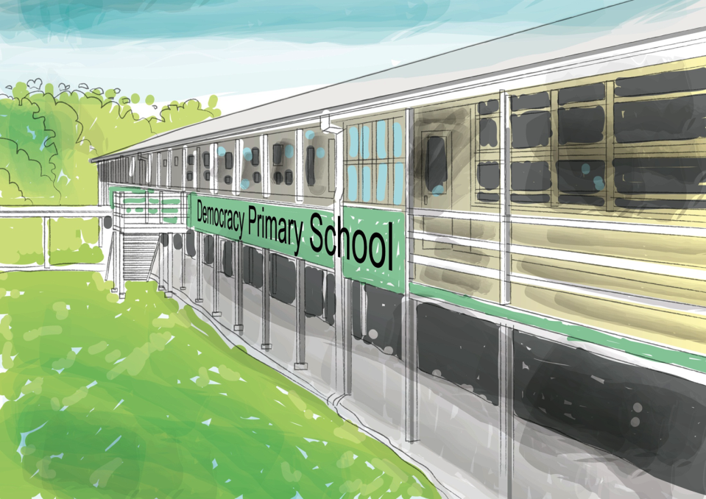
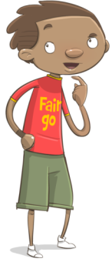
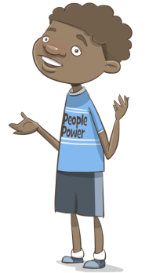
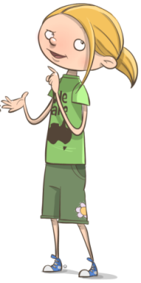
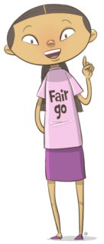
Civics and Citizenship explained…
Civics is what we ‘know’ about government and how our society is governed …
… and knowing how rules and laws affect our lives.
Citizenship is about joining in with our community, and what we ‘do’ to participate in and contribute to society.
Source: C2C Materials, Curriculum to Classroom, Government of Queensland, 2015

Slide 6
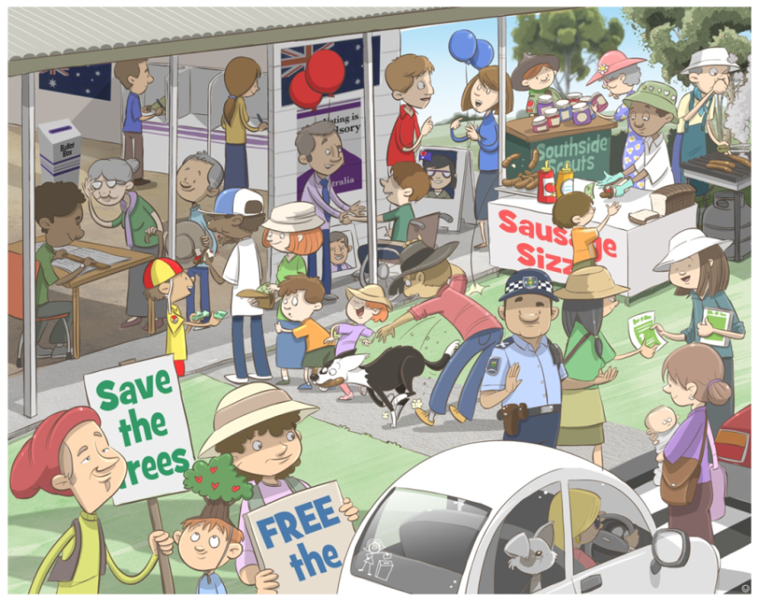
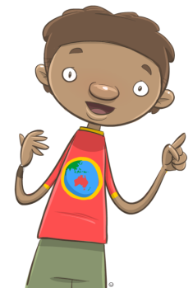
Is this Civics and Citizenship?
Citizenship is about joining in with our community, and what we ‘do’ to participate in and contribute to society.
… what rules and laws can you see being followed in the picture?
Source: C2C Materials, Curriculum to Classroom, Government of Queensland, 2015

Slide 7
Source: C2C Materials, Curriculum to Classroom, Government of Queensland, 2015

Slide 8
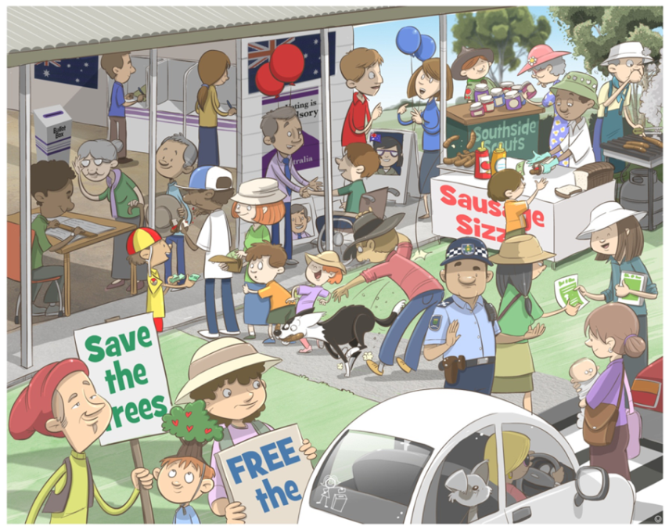
Source: C2C Materials, Curriculum to Classroom, Government of Queensland, 2015

Slide 9
Source: C2C Materials, Curriculum to Classroom, Government of Queensland, 2015

Slide 10
Rules and laws
Write down some rules and laws that you know.
Why are rules and laws are important?

Slide 11
Possible rules or laws
You may have thought of:
Do not commit violence against others.
No smoking inside public places.
Must have a ticket to travel on a train or bus.
Do not steal.
No littering allowed.
Dogs must be on a lead in some public places.
Must have a licence to drive a car.
Must have a licence to own certain animals.

Slide 12
Why rules and laws are important
What was one of your reasons why rules and laws are important?
You may have noticed that many rules and laws exist, in order to keep people safe.

Slide 13
Your turn
Create a list of behaviours that we should ‘do’, to help us become better citizens. Examples might include:
allowing elderly people, or people with disabilities, to sit down when travelling on public transport
placing rubbish in the bins, not on the ground.
Write down other things that YOU ‘do’, or want to try to do more of, to make you a better citizen.

Slide 14
Vocabulary
Key Word | Definition
Civics | Civics is what we ‘know’ about government and how our society is governed and knowing how rules and laws affect our lives.
Citizenship | Citizenship is about joining in with our community, and what we ‘do’ to participate in and contribute to society.
Citizen | A person who lives in a particular town or city.
Community | A group of people that live in the same place or belong to a common group.
Democracy | A type of government where the power is in the hands of the people where they can use their power directly, or through people who represent them.
Diversity | The practice of including or involving people from different social and ethnic backgrounds and of different genders, religions, beliefs, etc.

